Slide 1




Task Management
process and scheduling
MENNANI BAHA EDDINE
DEGACHI AZZEDDINE
1

Slide 2


Overview of Task Management
Task management involves overseeing processes within an operating system, ensuring efficient execution and resource allocation. it enhances system performance, stability, and responsiveness. its key elements include process scheduling, state management, and resource handling.
2

Slide 3
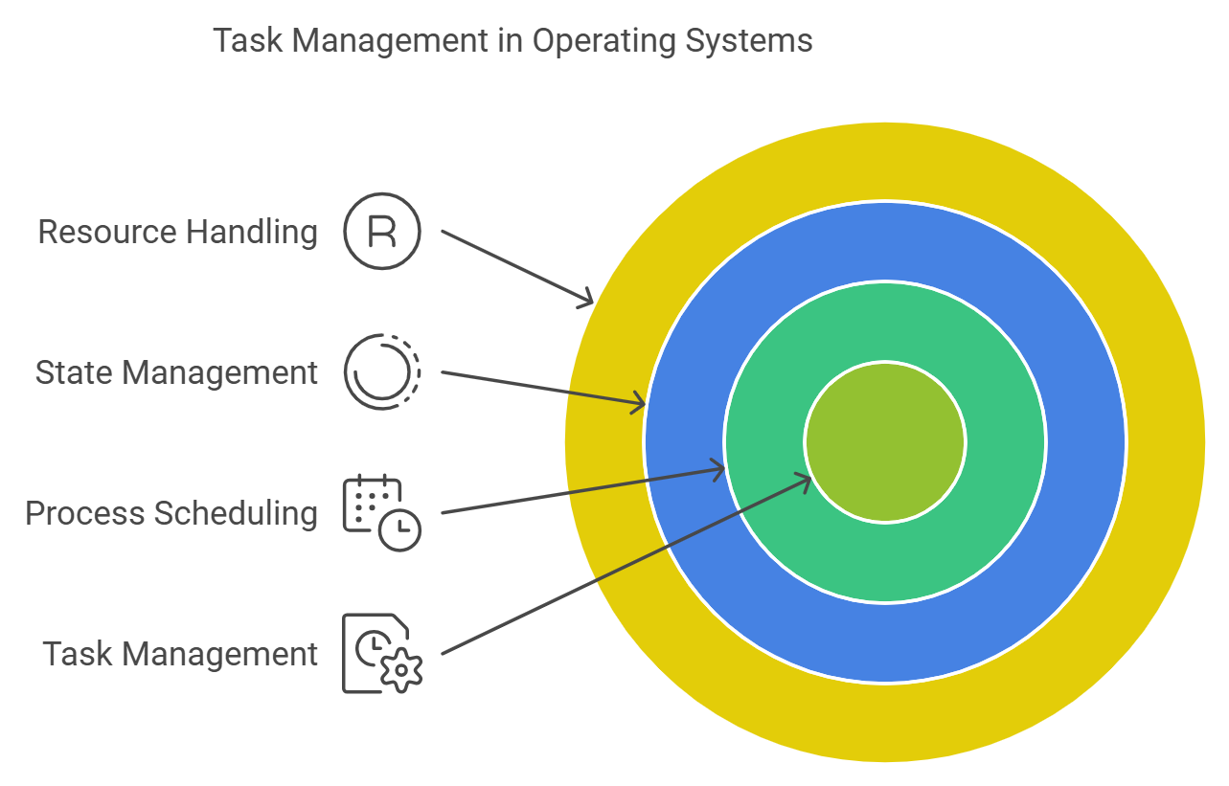
3

Slide 4
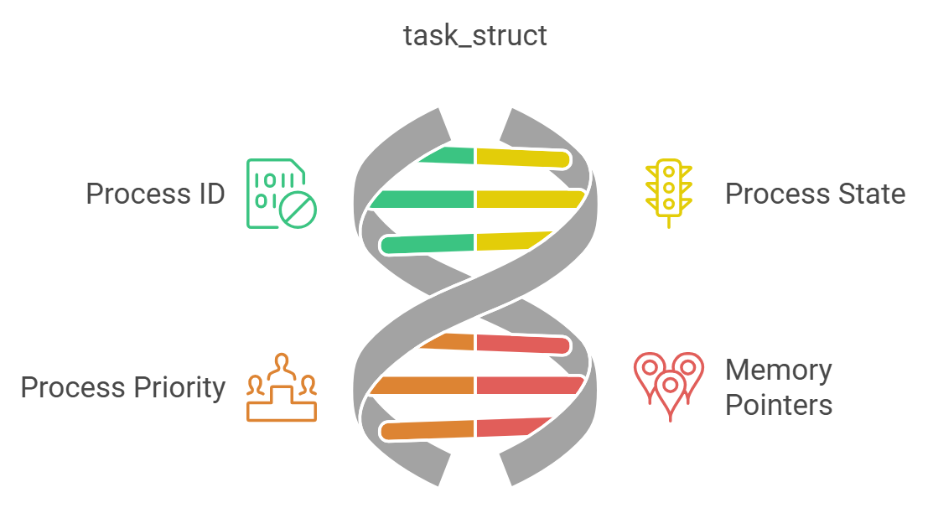
Task_struct Structure
In Linux, each process is represented by a task_struct data structure.
This structure contains process-specific information such as process ID, state, priority, and pointers to memory regions.
It serves as the primary descriptor for process management, facilitating scheduling and resource allocation.
4

Slide 5
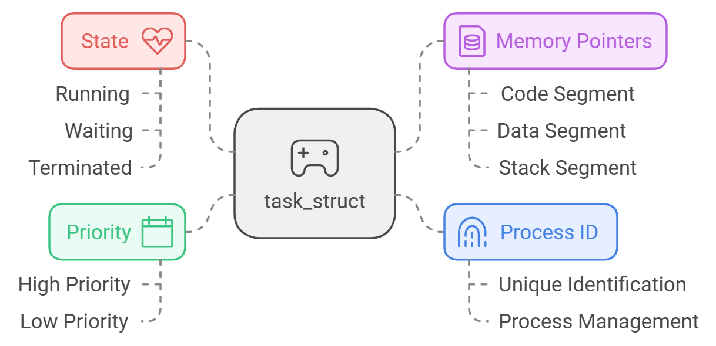
5

Slide 6
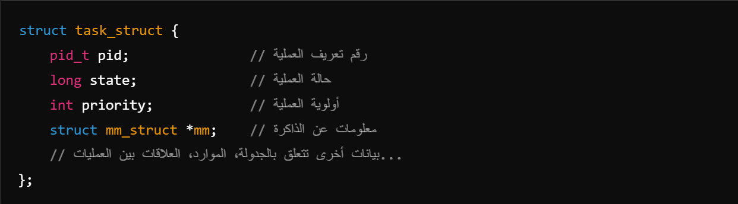
Practical example:
Importance of task_struct:
When running an application on a Linux system:
A new process is created.
The operating system creates a new entity from the task_struct structure to store the data of this process.
The operating system keeps track of the process status and execution priority using this entity.
Process Description:
This structure is the basic reference for all processes in the system.
A simple diagram of task_struct:
Process Scheduling:
The information stored in it is used to organize process priorities and distribute processor time.
Resource Management:
It facilitates the efficient allocation and management of resources (memory, files, etc.).
6

Slide 7
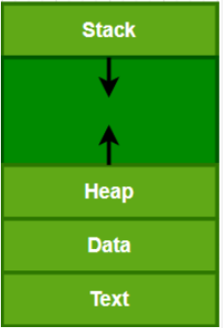
Memory sections in software processes
Process States
New: The process is being created.
Ready: The process is prepared to run and awaiting CPU allocation.
Running: The process is currently executing on the CPU.
Blocked: The process is waiting for an event or resource.
Terminated: The process has completed execution or has been stopped.
7

Slide 8
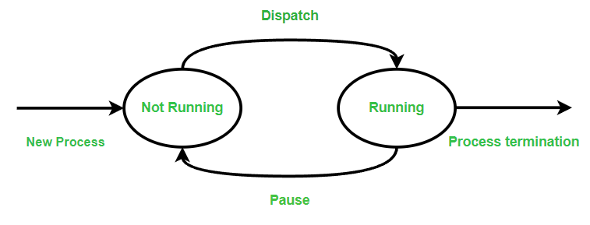
The Two-State Model
Running: This means the process is actively using the CPU to do its work
Not Running: This means the process is not currently using the CPU. It could be waiting for something, like user input or data, or it might just be paused.
8

Slide 9
The Five-State Model
The five-state process lifecycle is an expanded version of the two-state model. The two-state model works well when all processes in the not running state are ready to run. However, in some operating systems, a process may not be able to run because it is waiting for something, like input or data from an external device. To handle this situation better.
New: This state represents a newly created process that hasn’t started running yet. It has not been loaded into the main memory, but its process control block (PCB) has been created, which holds important information about the process.
Ready: A process in this state is ready to run as soon as the CPU becomes available. It is waiting for the operating system to give it a chance to execute.
Running: This state means the process is currently being executed by the CPU. Since we’re assuming there is only one CPU, at any time, only one process can be in this state.
Blocked/Waiting: This state means the process cannot continue executing right now. It is waiting for some event to happen, like the completion of an input/output operation (for example, reading data from a disk).
Exit/Terminate: A process in this state has finished its execution or has been stopped by the user for some reason. At this point, it is released by the operating system and removed from memory.
9

Slide 10
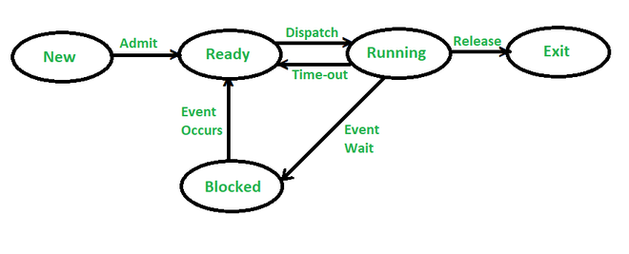
The Five-State Model
10

Slide 11
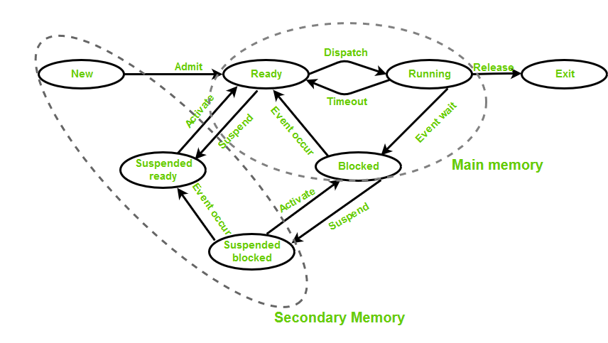
The Seven-State Model
11

Slide 12

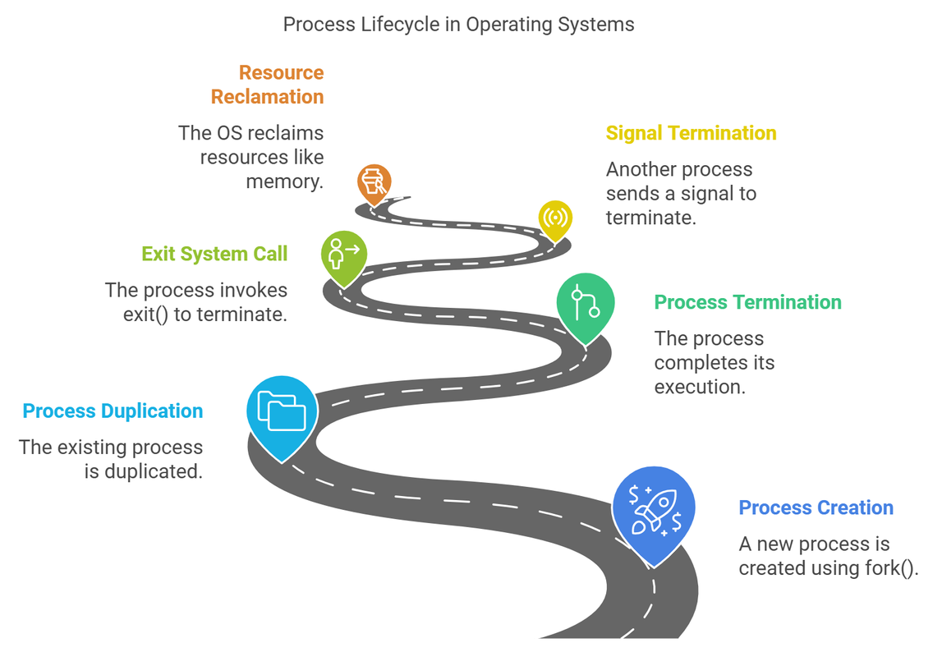

Process Creation and Termination
Processes are typically created using system calls like fork() in Unix-based systems, which creates a new process by duplicating the existing one.
Processes can terminate upon completion, by invoking the exit() system call, or be terminated by other processes using signals.
Resource Management: Upon termination, the operating system reclaims resources allocated to the process, such as memory and file descriptors.
12

Slide 13
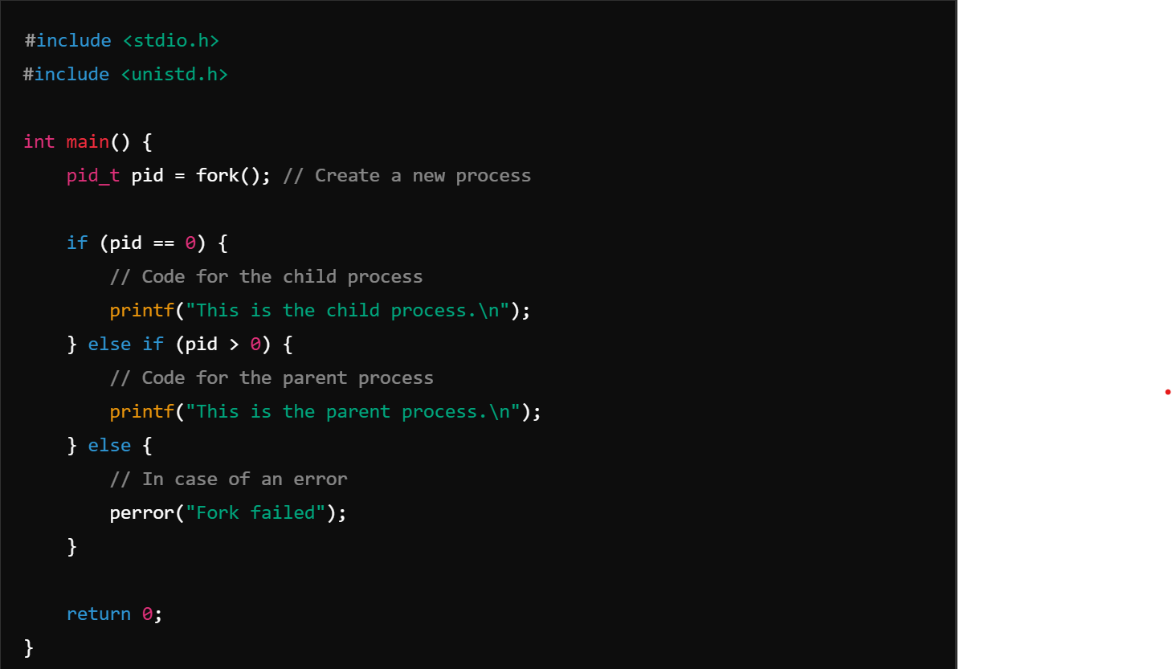
Process Creation:
Example of fork() Usage:
Creating a New Process:
The fork() system call creates an exact copy of the current process (called the Parent Process) and generates a new process called the Child Process.
The new process inherits many properties from the parent, such as the address space, open files, and environment variables.
13

Slide 14
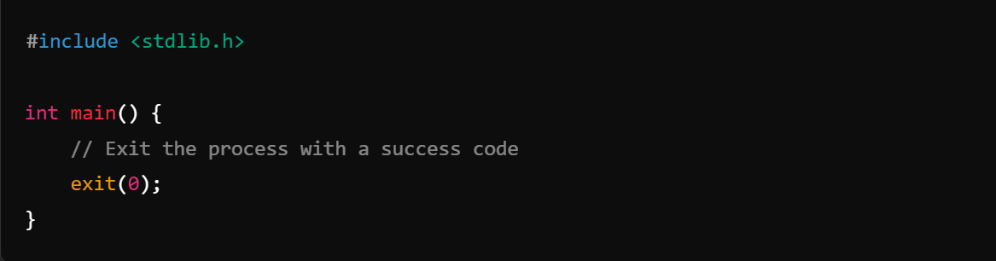
Process Termination:
A process can terminate in several ways:
Normal Termination:
The process ends its task upon completion and invokes the exit() system call to inform the system of its success or failure.
An Exit Status is sent to the operating system to indicate the process termination state.
Abnormal Termination:
If a process encounters errors such as memory access violations or invalid instructions, it is terminated by the operating system.
Termination by Signals:
Another process can send a signal to terminate a specific process using the kill() system call.
Example: SIGKILL immediately terminates a process.
14

Slide 15














Conclusion
Summary: Effective task management is crucial for optimal system performance and stability.
Future Trends: Emerging technologies like multi-core processors and distributed systems present new challenges and opportunities in process and scheduling management.
15

Slide 16

thank you!
16

